Slide 1















SPOTLIGHT ON...
COMPUTING AT SMAS

Slide 2



OBJECTIVES
  What is computing and why is it important?
  Computing National Curriculum
  The strands of Computing at SMAS
  Examples of Children’s work
  How parents can support at home
  Questions
Future Date: E-Safety Spotlight

Slide 3


WHAT IS COMPUTING?
Computing refers to the use of computers, technology, and digital tools to solve problems, create content, and communicate information. It’s not just about using devices, but understanding how they work and how to use them effectively in everyday life.
Notes:
Important:
give pupils the life-skills that will enable them to embrace and use new technology in a socially responsible and safe way
children become confident, independent users of computing technologies, gaining confidence and enjoyment from their activities.
develop reactivity, resilience and problem-solving and critical thinking skills.

Slide 4

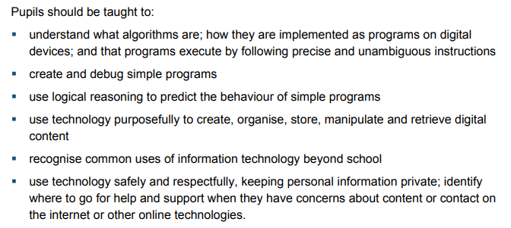
KS1 COMPUTING NATIONAL CURRICULUM
Notes:
Key Skills for KS1:
Basic programming concepts (sequences, loops, and instructions).
Introduction to digital literacy and the importance of online safety.
Develop familiarity with using various digital tools for creativity and learning.

Slide 5
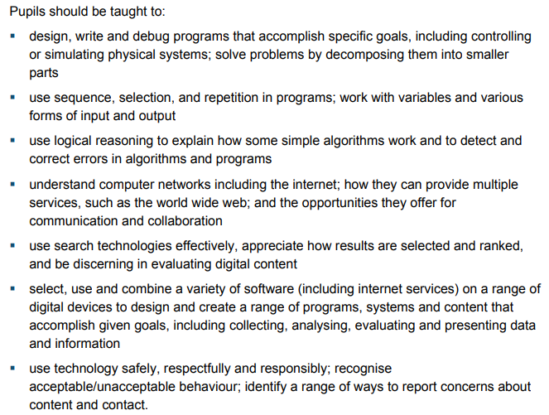
KS2 COMPUTING NATIONAL CURRICULUM
Notes:
Advanced programming (coding with logic, loops, and variables).
Digital citizenship and online safety.
Digital content creation and data handling.

Slide 6



THE STRANDS OF COMPUTING AT SMAS
Word Processing
Data
Presentation
Animation
Create, edit, and format written documents using basic computer tools.
Collecting, organizing, and using information in digital formats, such as text, numbers, or images.
Displaying information, images, and text to communicate ideas clearly.
Creating moving images or sequences to tell a story or explain a concept.
Computer Science and Programming
Video Creation
Digital Art
Augmented Reality
Recording, editing, and combining images, sounds, and text to produce short films or projects.
Creating of artwork using computer software and digital tools.
Overlaying digital information, like images or sounds, onto the real world through a device.
Learning how computers work and writing code to create programs or solve problems.
Y5 & 6 - AI
Notes:
AI, or Artificial Intelligence, is when machines or computers are made to think and learn like humans. It's like giving a computer the ability to recognize patterns, make decisions, or even understand language. For example, when you ask a voice assistant like Siri or Alexa a question, that's AI at work!
Everything is taught cross-curricular. Will see through examples of work that it is all part of our creative curriculum.

Slide 7

LET’S LOOK AT EACH STRAND IN MORE DETAIL...

Slide 8

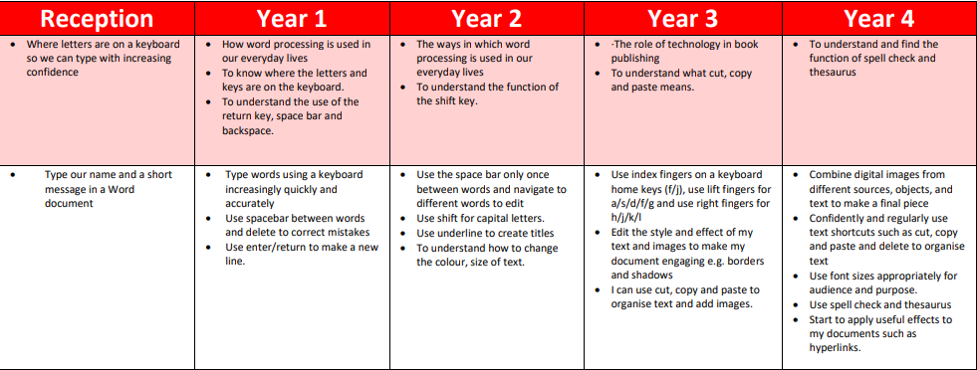
WORD PROCESSING
KNOWLEDGE
SKILLS
Notes:
Runs to Y4 - build up competency, accuracy and speed.
Touches on creativity in Y2 and then Y3 onwards add text formatting and other aspects e.g. images and links.

Slide 9
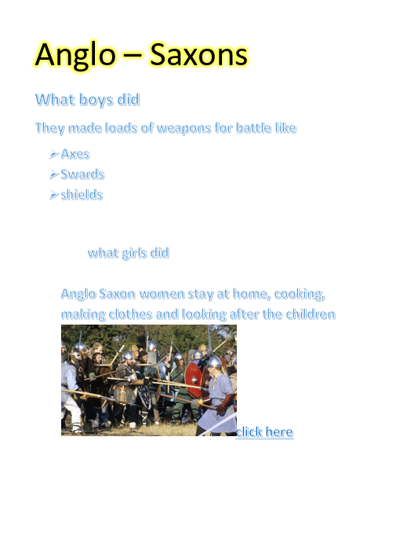
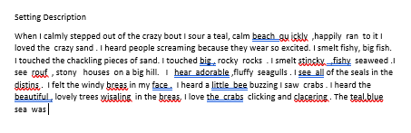
Y2 VS Y4 WORD PROCESSING:

Slide 10
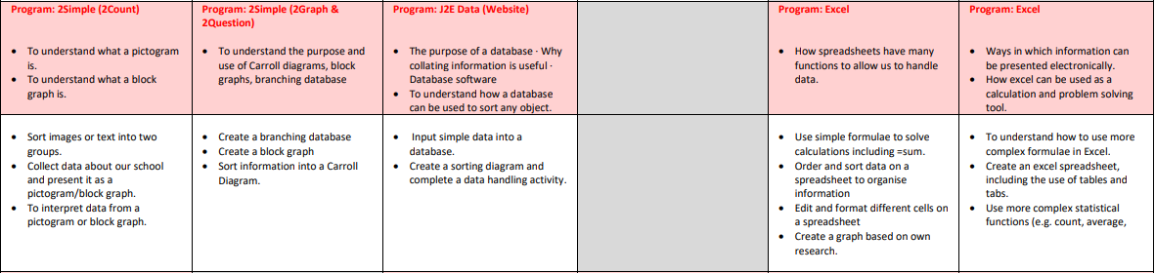
DATA
KNOWLEDGE
SKILLS

Slide 11
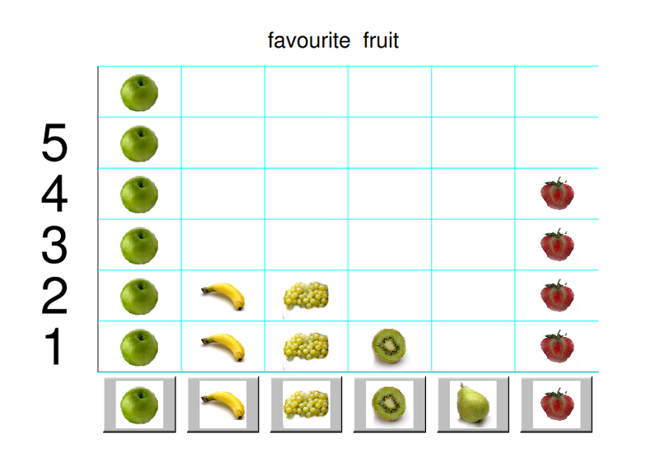
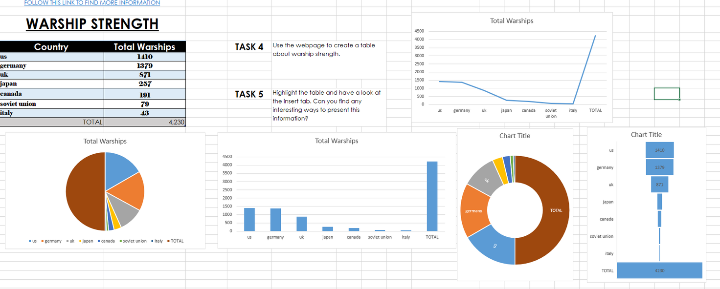
Y1 VS Y5 DATA:

Slide 12
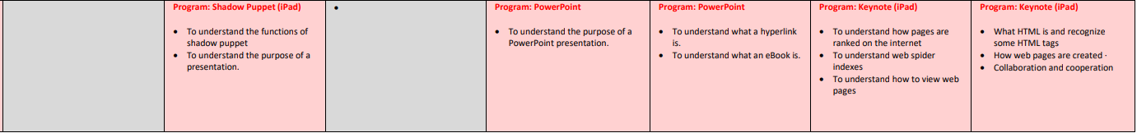
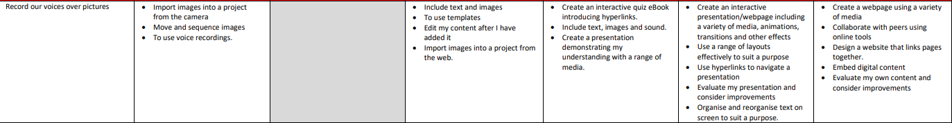
PRESENTATION
KNOWLEDGE
SKILLS

Slide 13

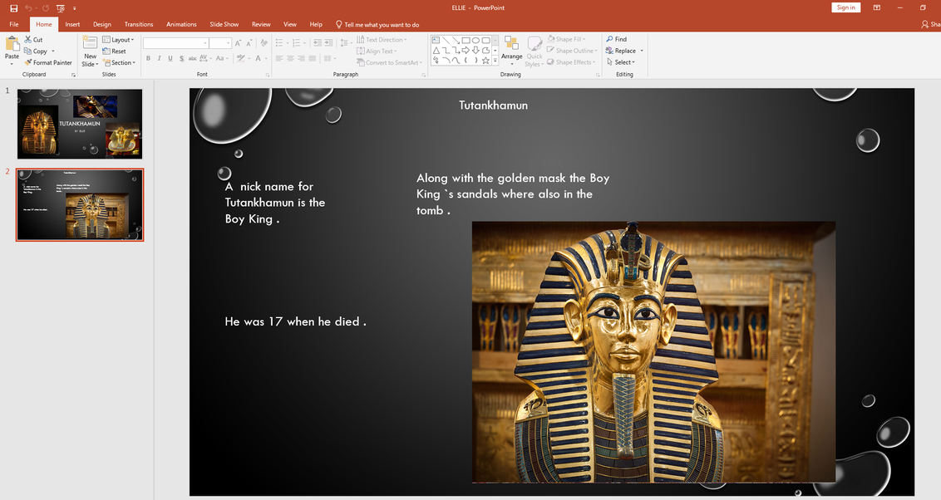

Y1 VS Y3 VS Y5 PRESENTATION:
Notes:
Y1 Seesaw
Y3 Powerpoint
Y5 Keynote

Slide 14
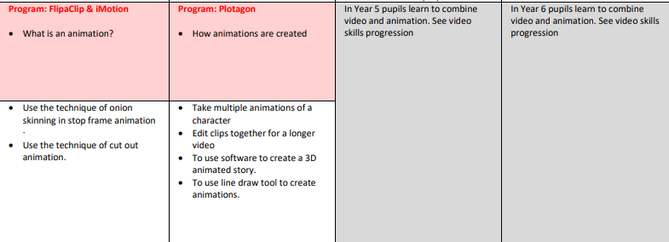
ANIMATION
KNOWLEDGE
SKILLS

Slide 15


Y3 VS Y4 ANIMATION:

Slide 16
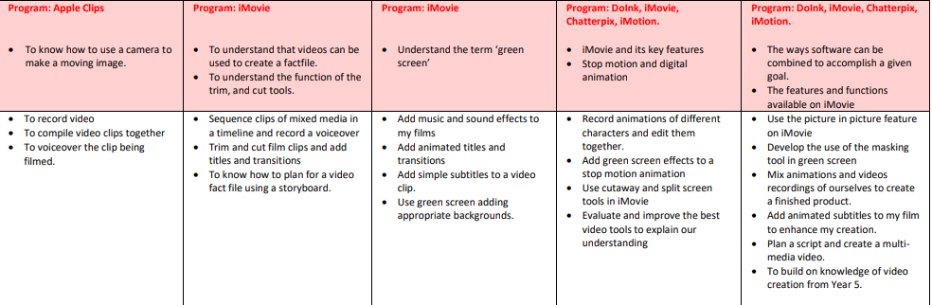
VIDEO CREATION
KNOWLEDGE
SKILLS

Slide 17
DIGITAL ART
KNOWLEDGE
SKILLS

Slide 18
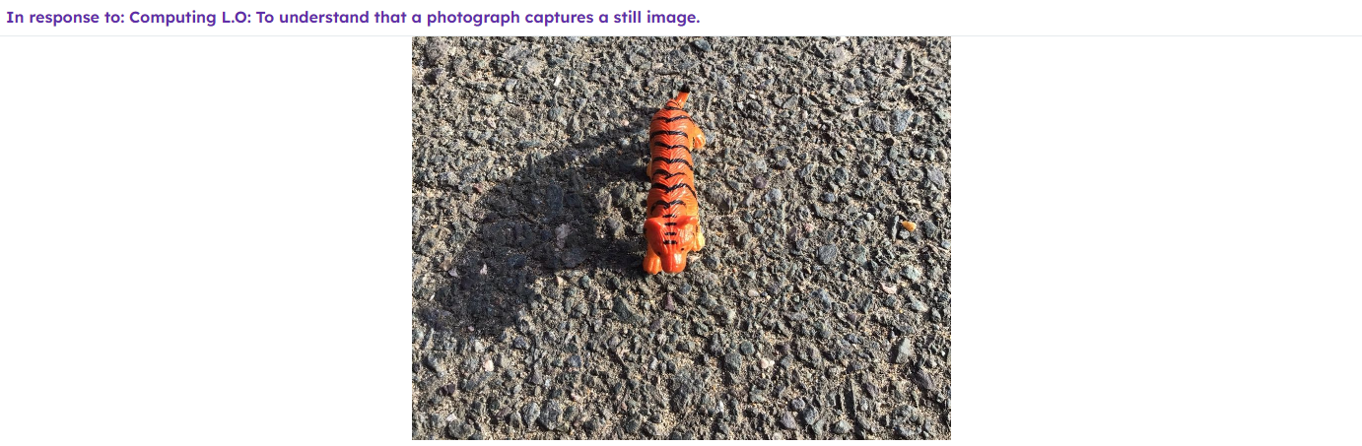
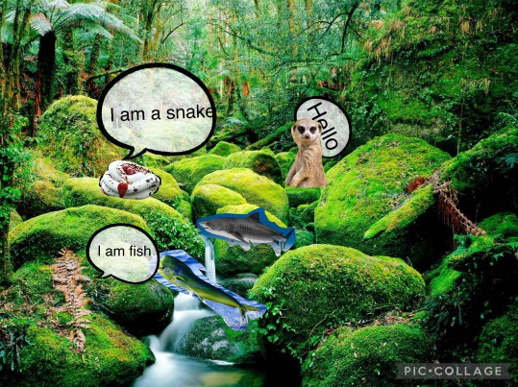
Y1 VS Y2 DIGITAL ART:

Slide 19
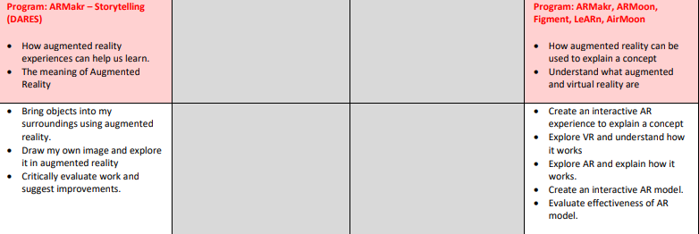
AUGMENTED REALITY
KNOWLEDGE
SKILLS

Slide 20
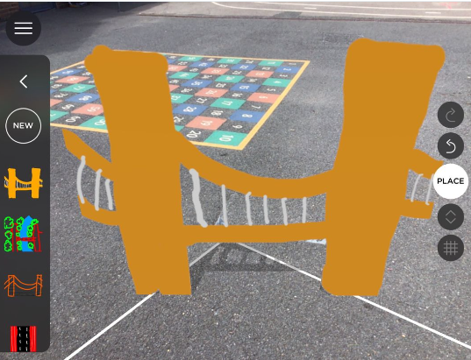
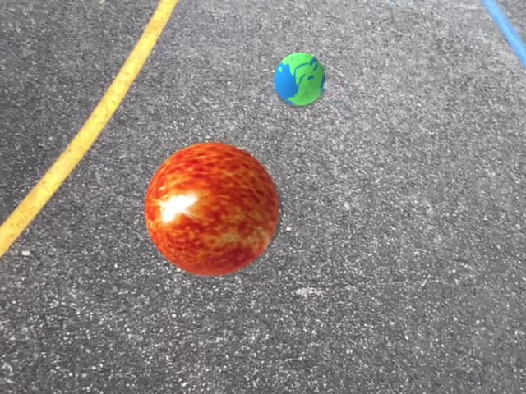
Y2 VS Y5 AUGMENTED REALITY:

Slide 21
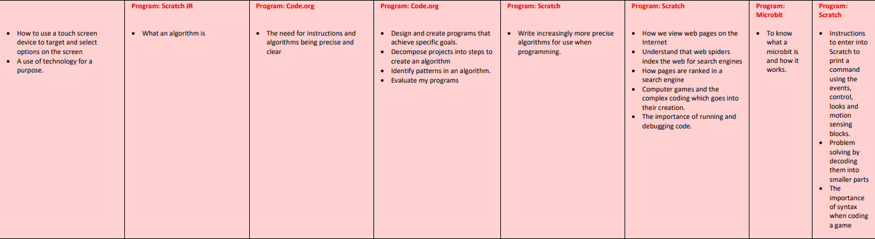
COMPUTER SCIENCE AND PROGRAMMING
KNOWLEDGE

Slide 22
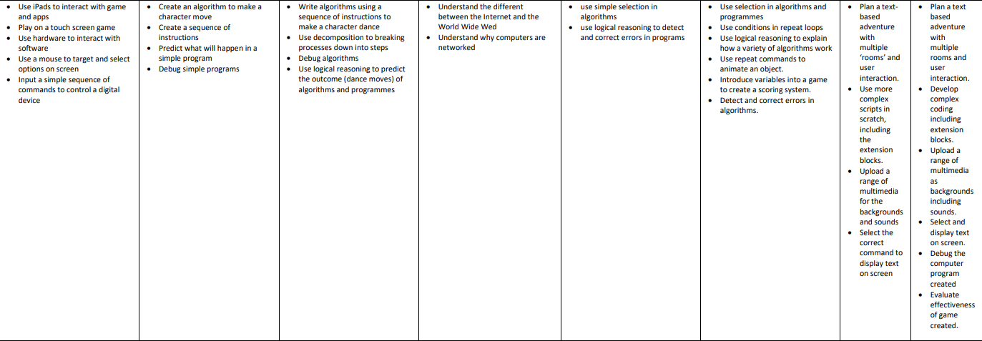
COMPUTER SCIENCE AND PROGRAMMING
SKILLS

Slide 23
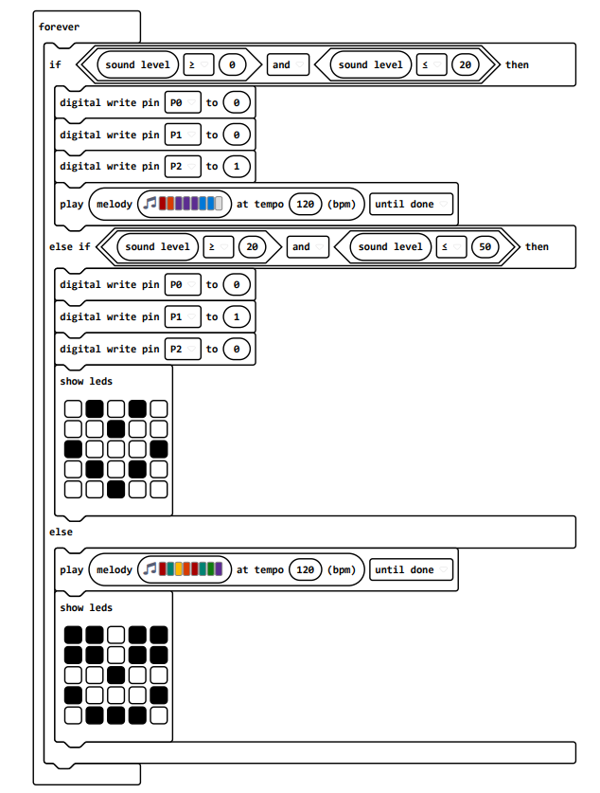
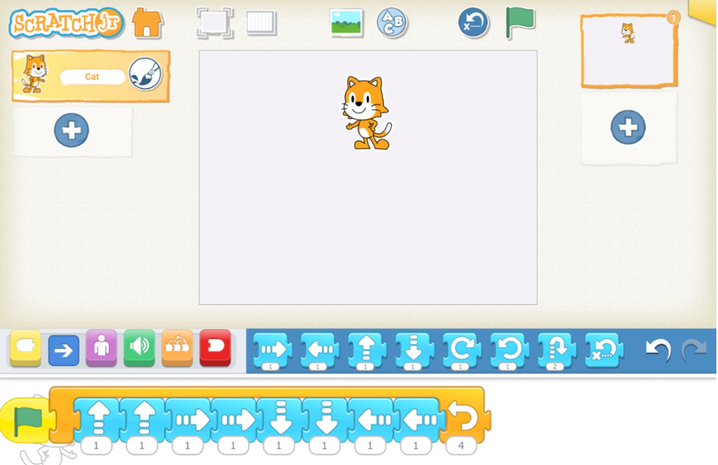
Y1 VS Y6 COMPUTER SCIENCE AND PROGRAMMING:

Slide 24
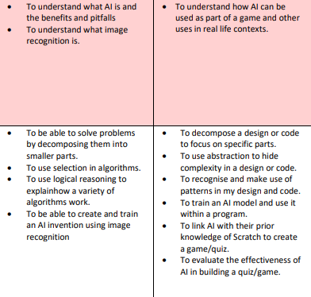
ARTIFICIAL INTELLIGENCE (AI)
KNOWLEDGE
SKILLS

Slide 25
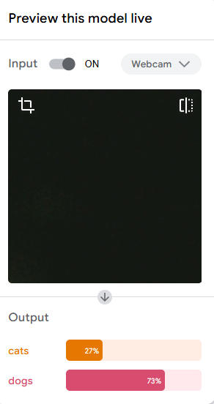
Y5 & Y6 AI

Slide 26



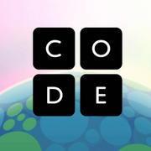



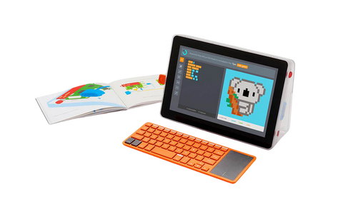
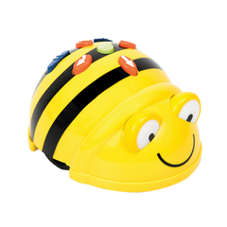
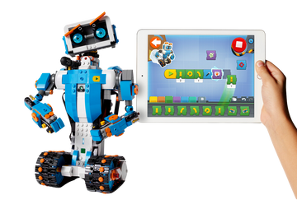

Model good habits: Show children how to use devices safely, and emphasise the importance of privacy and security online.
Experiment with apps: Let them try out some child-friendly app design platforms where they can design their own apps or games.
Online coding platforms: Websites like Scratch Jr (KS1), Scratch (KS2) or Code.org offer child-friendly coding tutorials that encourage problem-solving and creativity.
@ HOME SUPPORT
Home learning: Use this as an opportunity to explore new technolgoies and new ways to present learning. Enables greater accessibility to tasks.
Robots and programmable toys: Toys like Bee-Bots, Kano kits, or Lego Boost can teach children the basics of coding in a hands-on way. These toys help make abstract concepts more concrete and fun.
Typing: Such a key skill that takes time to practise. TypingClub and DanceMat Typing are excellent websites for this.

Slide 27
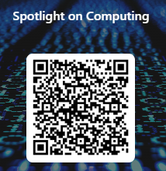
THANK YOU VERY MUCH!

