Slide 1



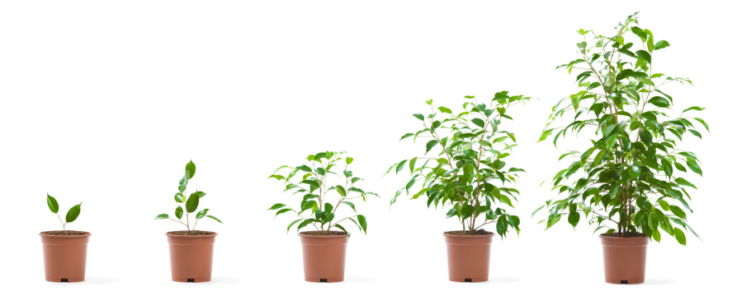

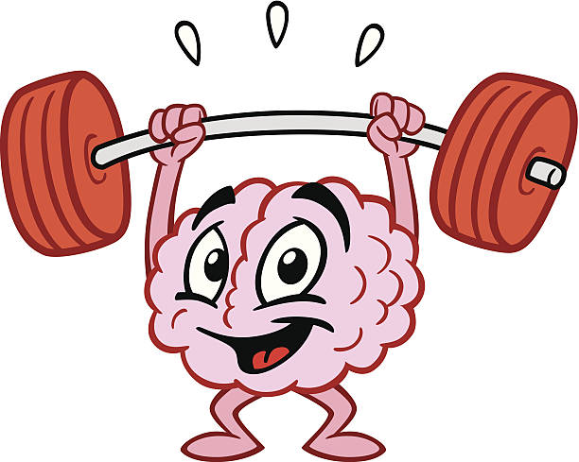
The Language of Learning
Notes:
The way we talk about learning has a significant impact on children’s attitude to their learning and ultimately, their life chances.
This is not just about academic learning, school-based education. This is about understanding themselves as life-long learners, being curious about the world and open to new challenges, and seeing failure as an essential part of learning.
It is about finding the balance between building self-esteem and understanding they are a work in progress, which is what all of us are.
So…. Our role modelling is crucial.

Slide 2
“Evidence suggests the use of ​‘metacognitive strategies’ – which get pupils to think and talk about their own learning – can be worth the equivalent of an additional +7 months’ progress when used well.”
Education Endowment Foundation
EEF’s research explains the value of explicitly teaching pupils metacognitive strategies, including how to plan, monitor, and evaluate their learning.

Slide 3
Planning—encouraging pupils to think about the goal of their learning and to consider how they will approach the task;
Monitoring - pupils to assess the progress they are making and make changes to their chosen strategies;
Evaluating - appraising the effectiveness of their plan and its implementation.
Learn not ‘do’
Instead of:
I’M NO GOOD AT THIS!
I CAN’T DO IT!
I’M RUBBISH!
I’LL NEVER BE ABLE TO DO THIS!

Slide 4
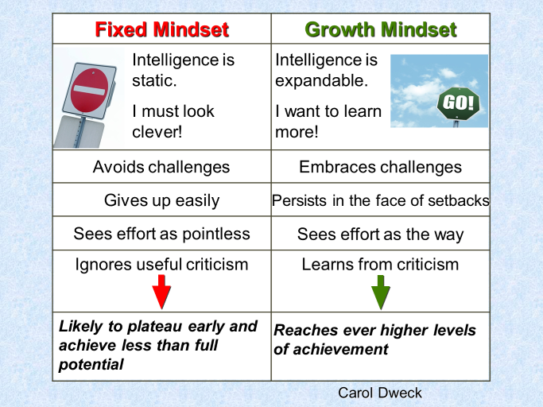
Traits of Fixed and Growth Mindsets

Slide 5
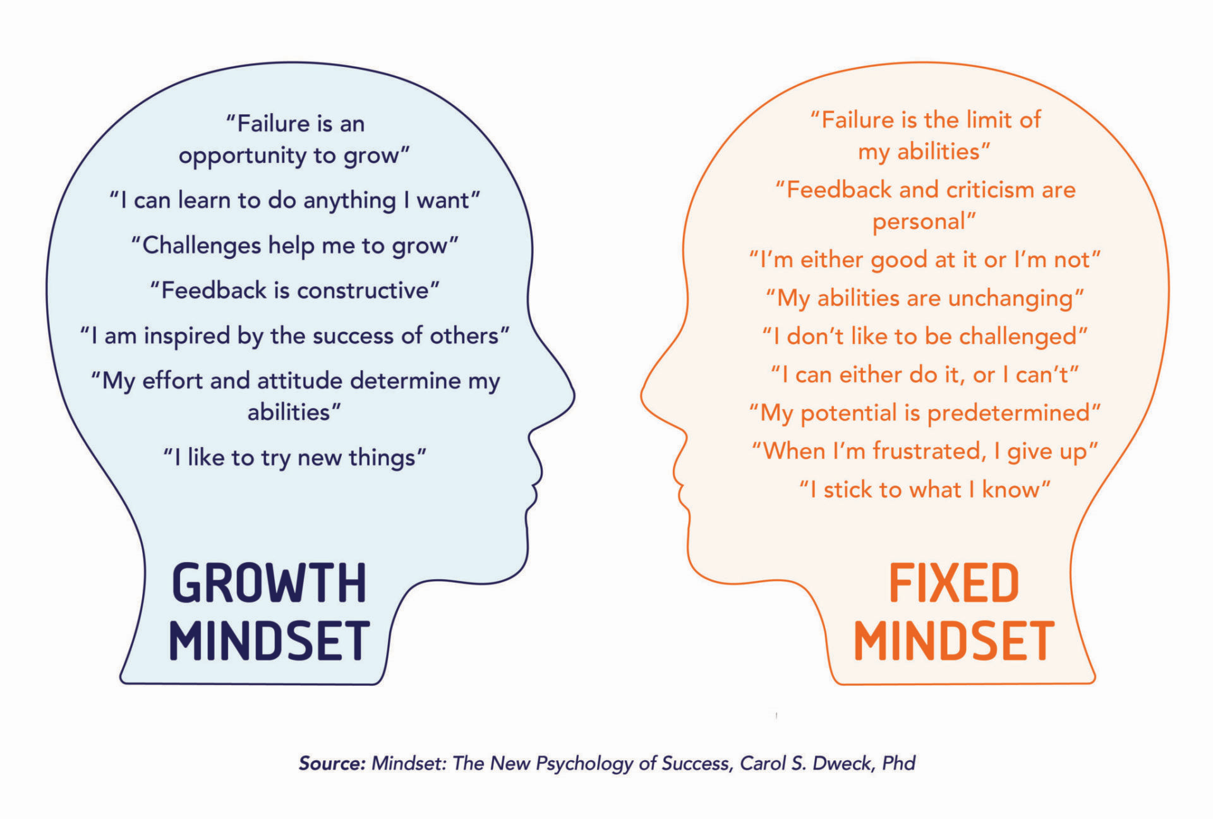
Self-talk

Slide 6
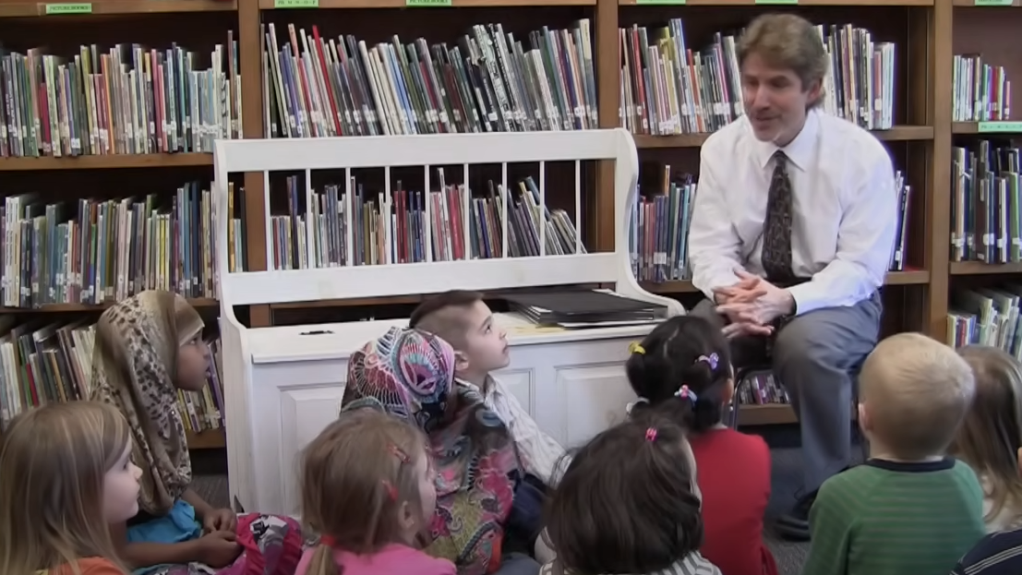
https://www.youtube.com/watch?v=E_6PskE3zfQ 6 minutes
Watch this video: Austin’s Butterfly

Slide 7
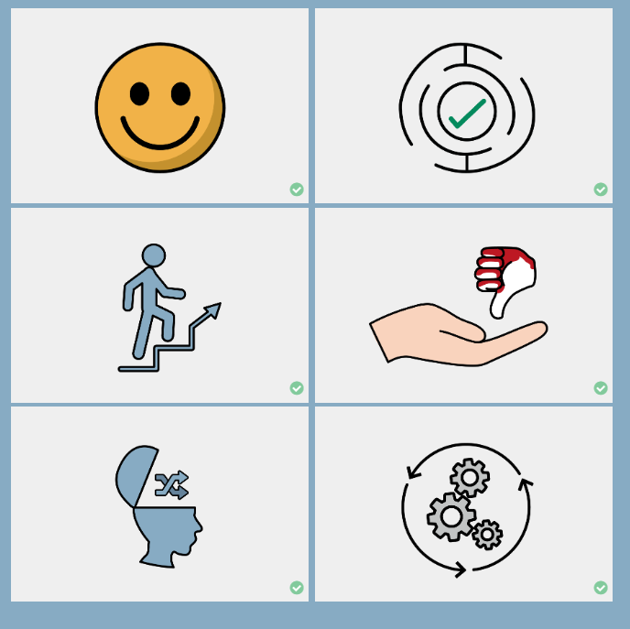
Strategies to develop a growth mindset
BE POSITIVE
A child’s attitude has the biggest impact on their level of performance.
WELCOME CHALLENGE
Children should see challenges as opportunities to learn. They should not be afraid of making mistakes.
PUT IN THE EFFORT
If a child puts their best effort into a task, they will enjoy the reward of achievement more.
EMBRACE THEIR OWN IMPERFECTIONS
If they are constantly striving for perfection, children will be disappointed. Instead, they should do their best and celebrate their achievements.
Which of these do we model to our children?
BE OPEN TO CHANGE
If they do the same thing, they’ll get the same results. Child should have confidence to try different strategies to find success.
TRY, TRY, TRY AGAIN
Setbacks should not cause children to give up but should be seen as a positive signal to try another way, as part of the journey to success.

Slide 8
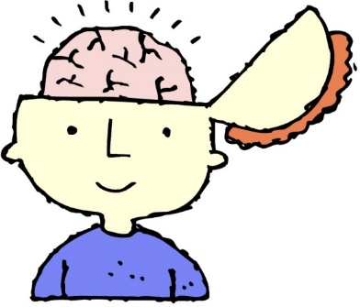
Praise achievement not ability
Our language tells children what we believe and what we value
Well done - you’re learning to...
Good - it’s making you think - that’s how your brain is growing!
Every time you practise, you’re making connections in your brain stronger.
You’re good at things you like because you work at them.
Shirley Clarke

Slide 9
Praise process and attitude not ability
Our language tells children what we believe and what we value
Let’s look at what you’ve achieved.
If you could already do it, you wouldn’t be learning anything.
Your skills have really improved.
You can use this mistake. Think about why it didn’t work and learn from it.
Shirley Clarke

Slide 10
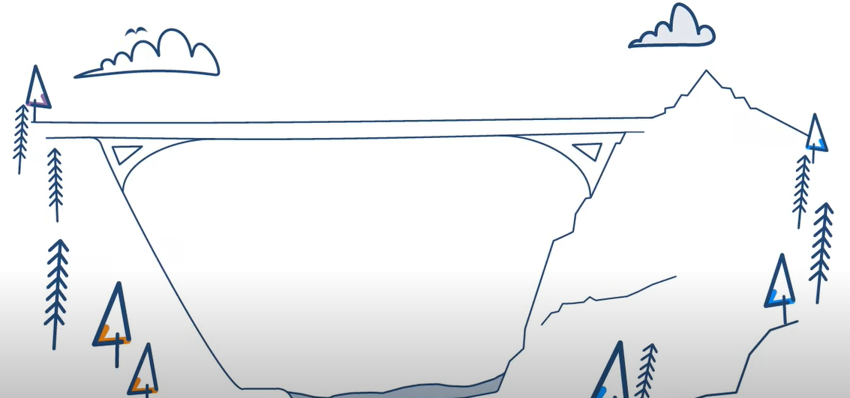
The Learning Pit – James Nottingham
https://www.youtube.com/watch?v=8pdYmAbWR-k 2mins

Slide 11
Embracing Challenge – our aims
To approach difficult tasks positively.
To want to struggle.
To encourage those who are familiar with struggle.
To take the fear out of struggle for the Brittle Bright.
To look for the challenge in every task.
For self-esteem not to be damaged by failure.

Slide 12

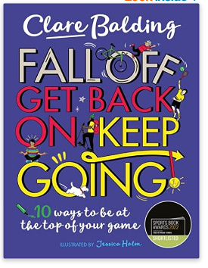
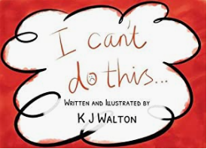



Books for Children to encourage Growth Mindset

Slide 13
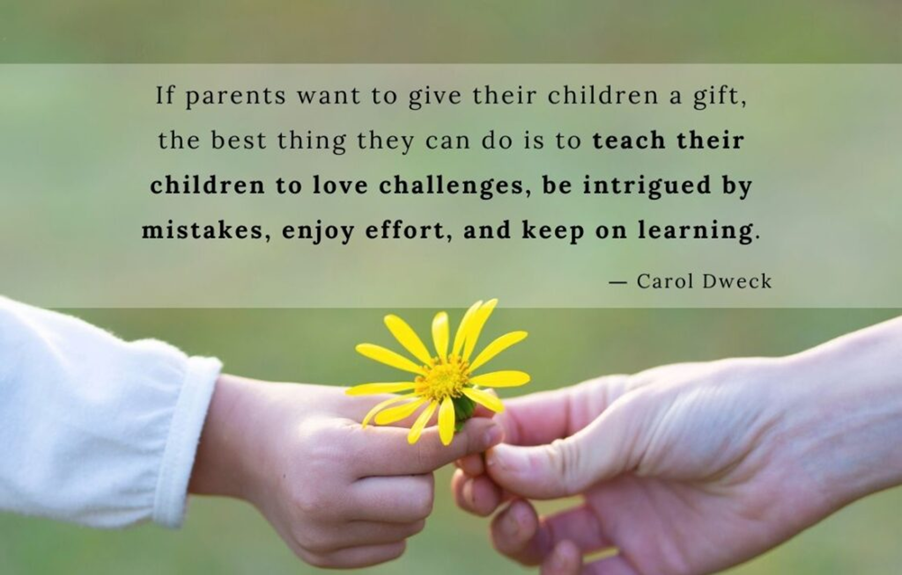
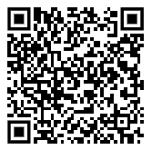
FEEDBACK

Slide 14
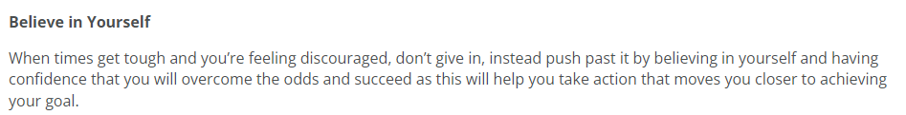
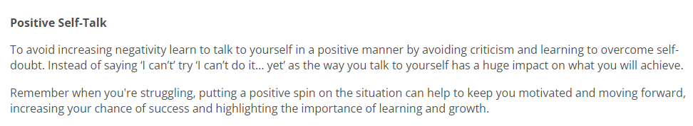
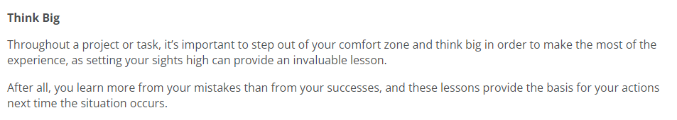
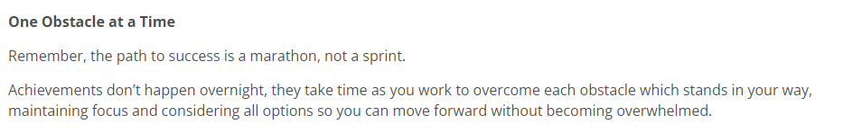
Modelling for Our Children

