Slide 1
Spotlight on Oracy
Please look at the card on your seat and talk to the people around you.

Slide 2
Focus for today
1. Develop an understanding of Oracy and why it matters.
2. Understand how we are increasing the quality and impact of pupil-to-pupil and teacher-pupil spoken interactions in lessons.
3. Take aways.

Slide 3
What is oracy?
The Oracy Education Commission’s (OEC) report argues that oracy education should be an essential entitlement for children from all backgrounds.(We need to talk, October 24)
It comes after the Labour government signaled that oracy would be an integral part of future education policy with inclusion in the Curriculum and Assessment Review, due to be published in 2025. In fact the OEC are calling for it to be the 4th ‘R’ Reading, writing, arithmetic and oracy.
Oracy means articulating ideas, developing understanding and engaging with others through speaking, listening and communication.

Slide 4
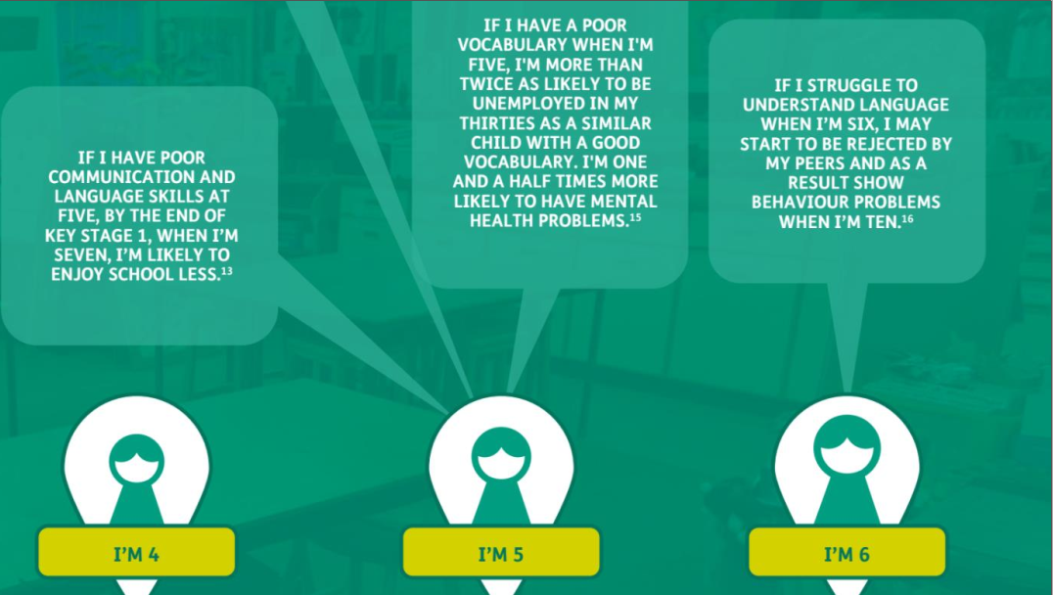
Notes:
So why?

Slide 5
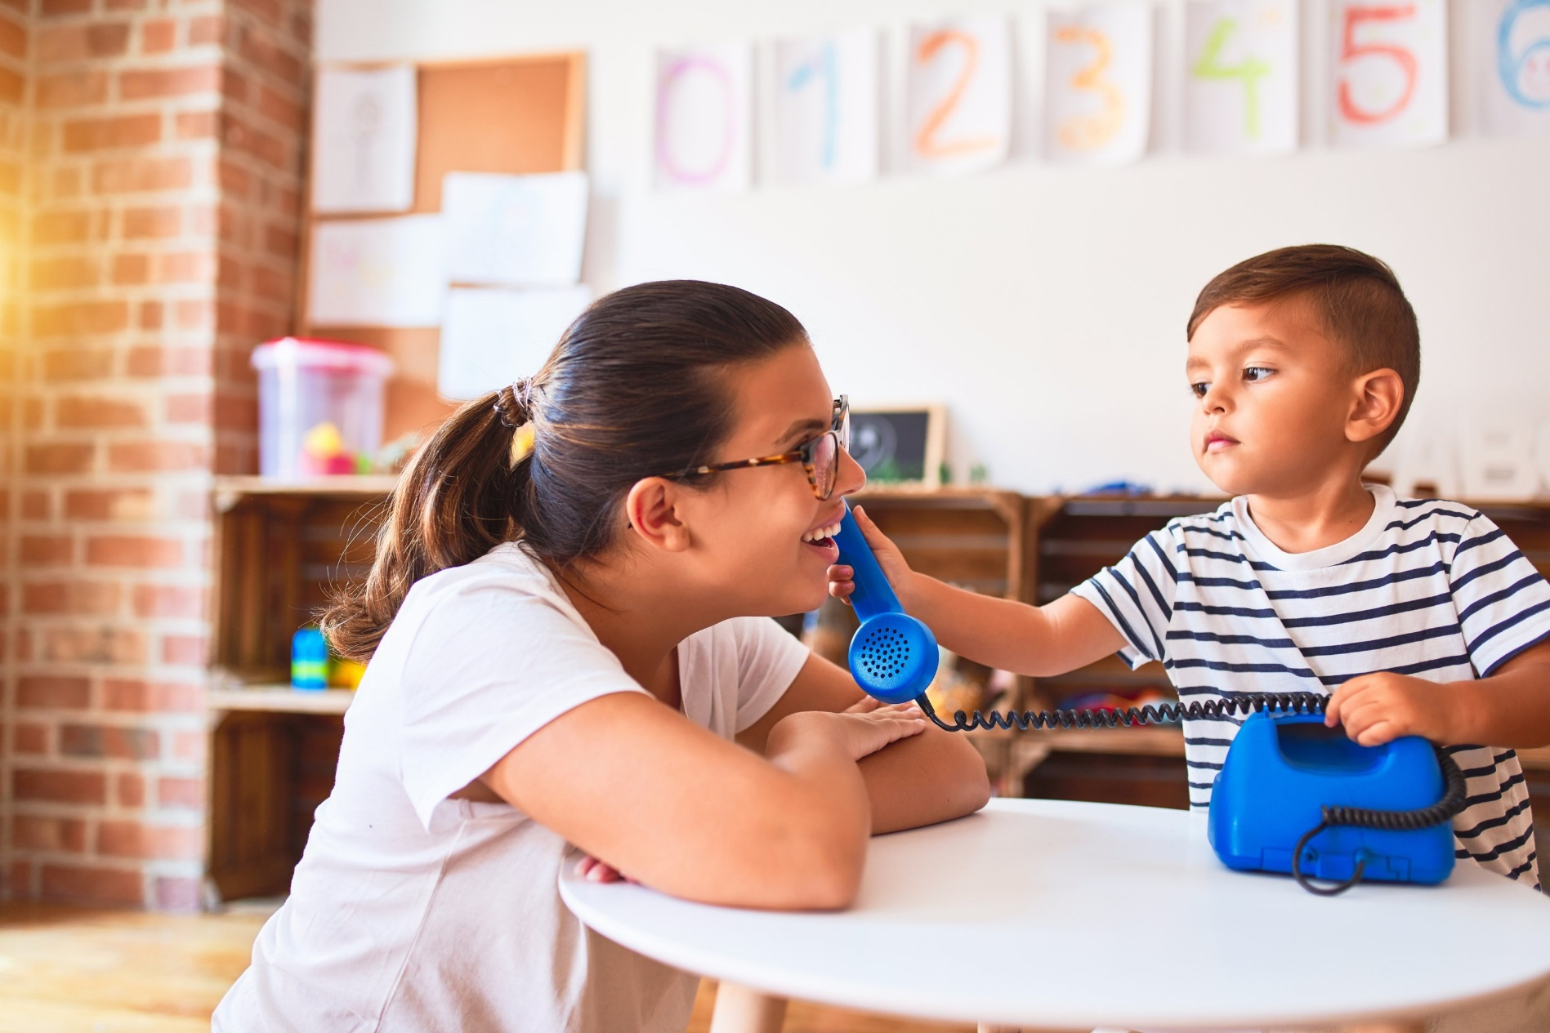
The amount and the quality of the conversation children experience at home: (a) varies enormously (b) is a good predictor of eventual academic attainment. Roy, Chiat & Dodd (2014) Law et al. (2017)
“Children who used devices such as iPads and iPhones had a higher risk of an expressive language problem at 18 months of age. van den Heuvel et al 2019

Slide 6
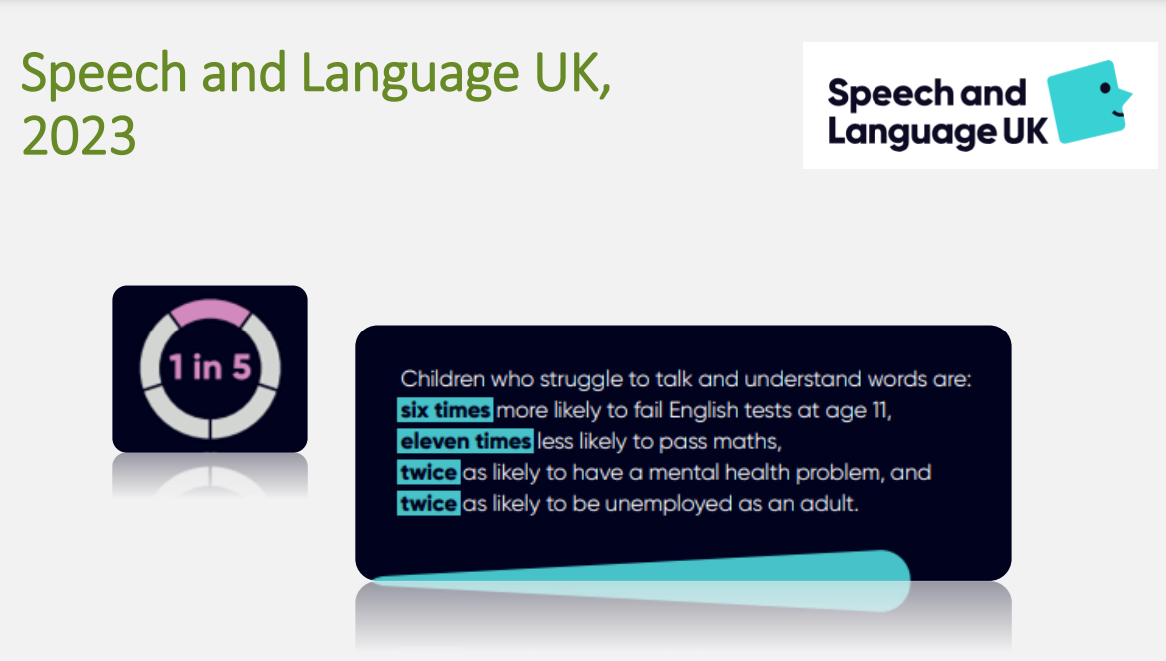

Slide 7
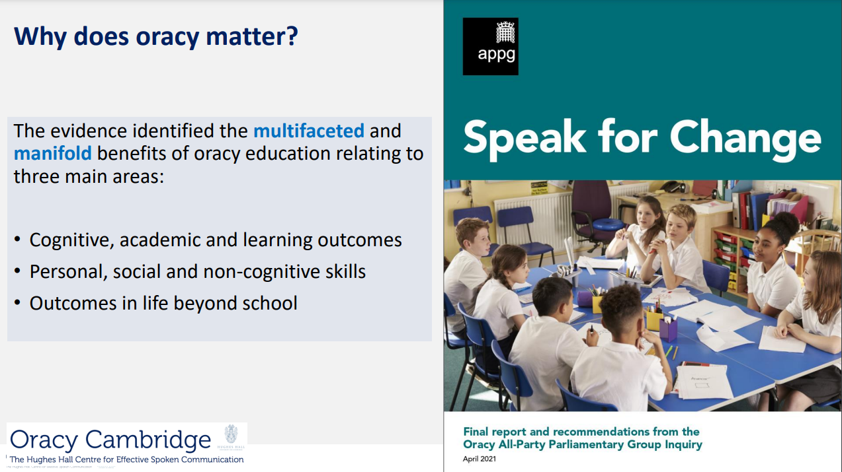

Slide 8

Area for improvement
What we saw in the classrooms:
* Teachers were doing quite a lot of talking.
* Most children were engaged but not all children were contributing as much as we would like.
* Children were putting their hand up and the teacher was directing the talk like a conductor.
Notes:
Here at St Marys, Oracy was an area of improvement which we had already identified through learning walks and lesson observations in September. We noticed that although obviously classroom talk was happening and all children were being encouraged to be involved:

Slide 9
Our oracy vision
We want to imagine a classroom where:
Every child speaks confidently and eloquently.
Every child can be heard sharing their ideas and thoughts.
Every child is not afraid to experiment and try out ideas verbally, even if they are unsure.
Every child works collaboratively in all different types of groups.
Every child understands that talking helps them think and develop ideas.
Every child wants to understand different perspectives.
Talk is a significant feature of all lessons across the curriculum and the children can lead those discussions.
The classroom is alive with ideas, discussion and debate.
Notes:
Through learning walks and lesson observations in September, we noticed that although obviously classroom talk was happening and all children were being encouraged to be involved:

Slide 10
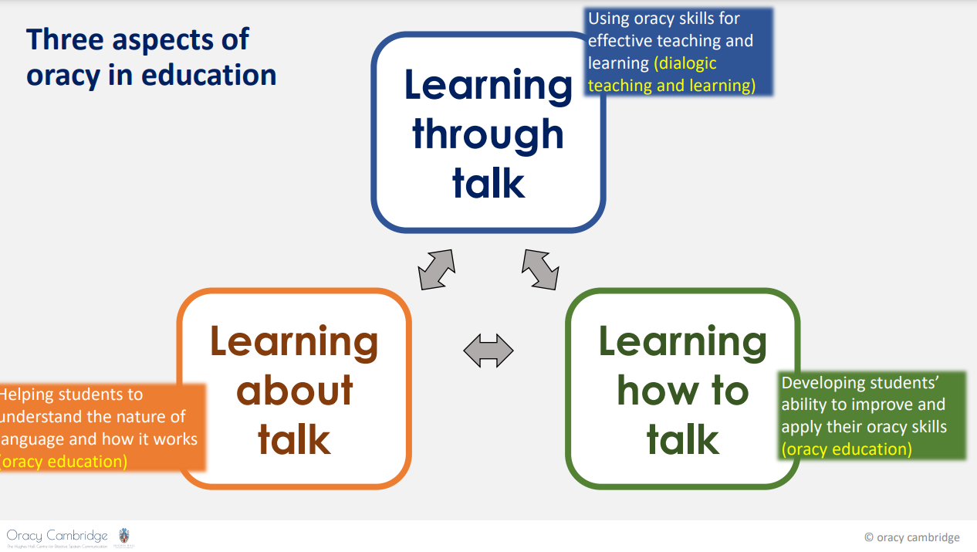

Slide 11
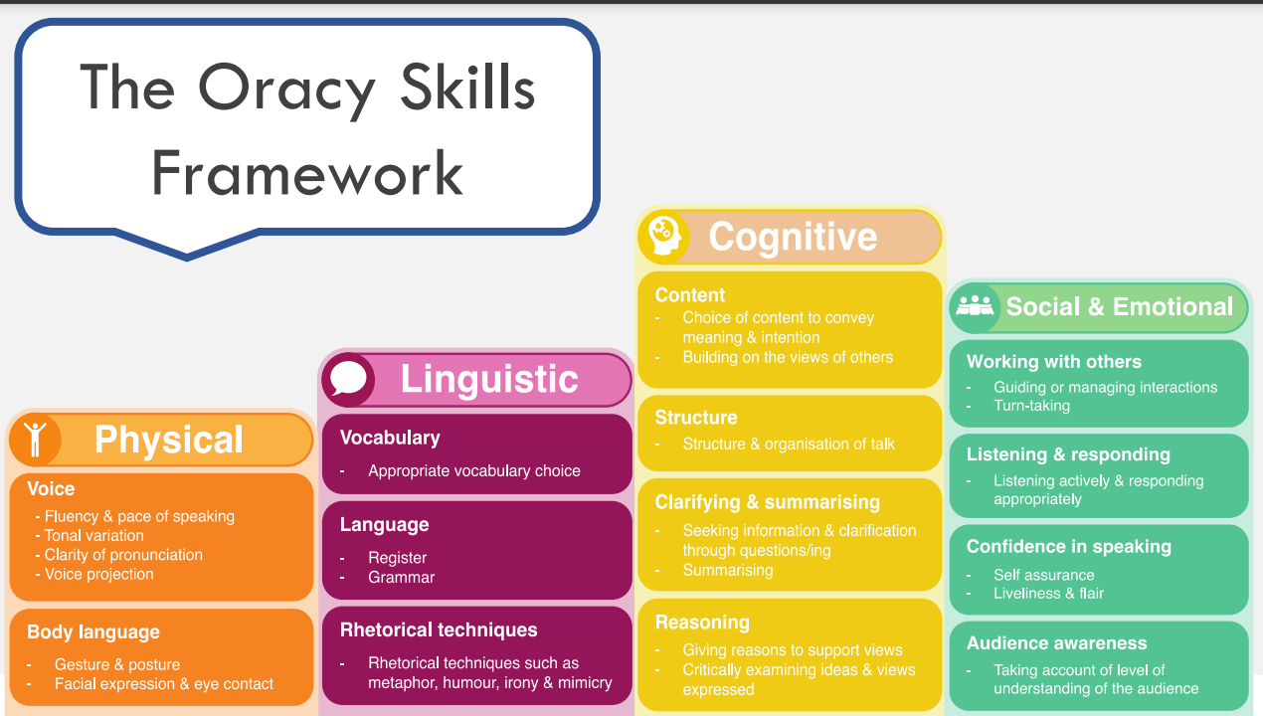
Notes:
Oracy Cambridge

Slide 12
What are we doing?
A whole school approach to Oracy in order to raise its profile and develop as many opportunities as possible for the children to hone their oracy skills.
Weekly training in our staff meeting.
Modelling of oracy skills to set high standards and expectations.
Encouraging the children to work in different groupings to develop different skills.
Each class is developing Talk Rules which look something like this:

Slide 13
A example of a set of class of Talk Rules
We will share what we know with each other.
We will respect everyone’s opinions and ideas.
We will listen carefully to others and consider what we hear.
We will try and give reasons for what we say.
We will show we are listening by tracking each other.
We will encourage everyone to contribute.
We will challenge one another politely and respectfully.

Slide 14

Notes:
More specifically …..

Slide 15
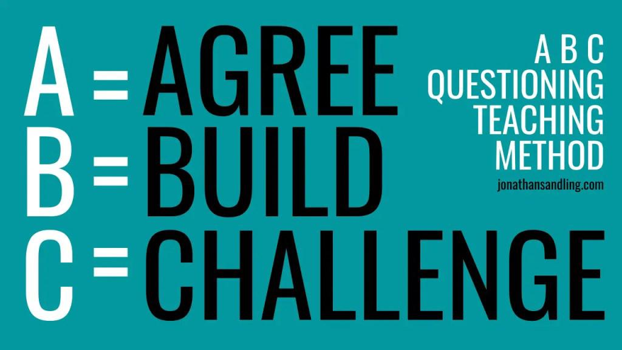

Slide 16
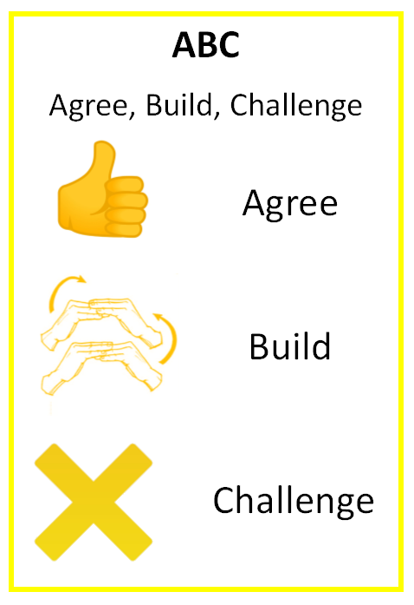

Slide 17
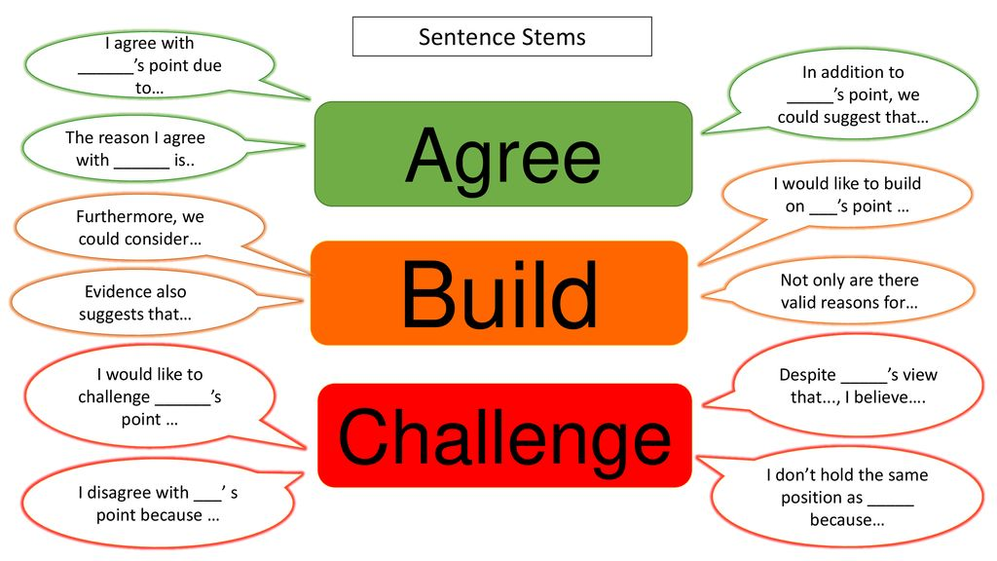

Slide 18
Over to you!
Tourist trips to space
Good idea / bad idea
Notes:
ABC in action

Slide 19
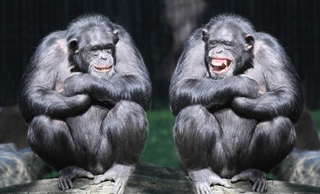

Chatter Matters
Take aways
* Oracy is an issue of equality, equity and social mobility.
* Oracy increases engagement in learning.
* Oracy fosters wellbeing and confidence.
* Strong oracy skills equip children for their future.

Slide 20
So…..
* Encourage children to talk both to you and their peers and model actively listening.
* Encourage children to have partial thinking.
*Allow different opinions and encourage them to be explained.
* Ask questions that don’t have a right or wrong answer.

Slide 21

Spotlight on Oracy
Please fill in the feedback form so that we can make improvements for next time!

