Slide 1

Spotlight on SEND
04/10/24

Slide 2
Special educational needs and disabilities
Send at St Marys
Time to connect

Slide 3
What do we mean by SEND?
Children and young people with SEND all have learning difficulties or disabilities that make it harder for them to learn than most children and young people of the same age. These children and young people may need additional or different help from that given to others.
Settings and schools have a person who is responsible for making sure children or young people with SEND get the right support. This person is called a Special Educational Needs and Disabilities Coordinator, or SENDCo. A SENDCo coordinates the provision for SEND in a setting and collaborates with parents, children, staff and external professionals to ensure children are supported appropriately.

Slide 4
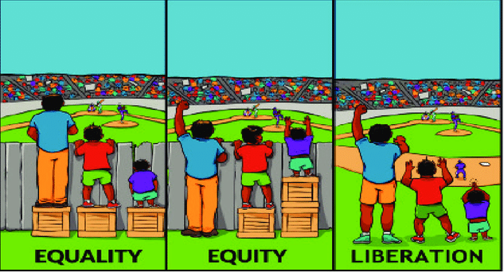

Slide 5
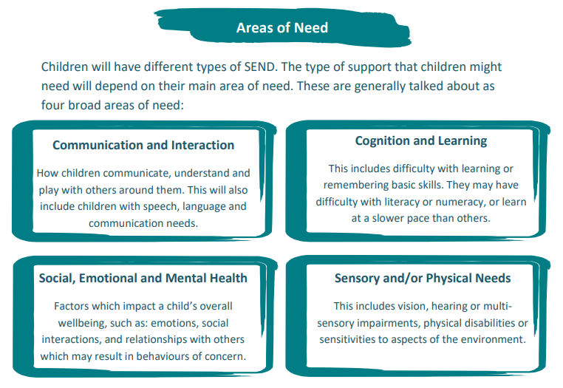

Slide 6
How do we support children with SEND at St Marys?

Slide 7
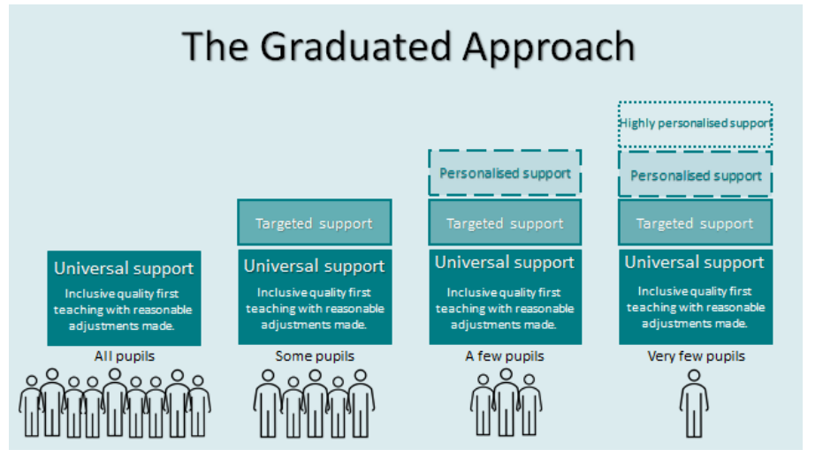
The graduated approach
The Graduated Approach expects settings and schools to make full use of all their resources and expertise before accessing increasingly personalised support.
By continually monitoring all children, settings and schools can decide on the most appropriate level of support for all children, including those with SEND.

Slide 8
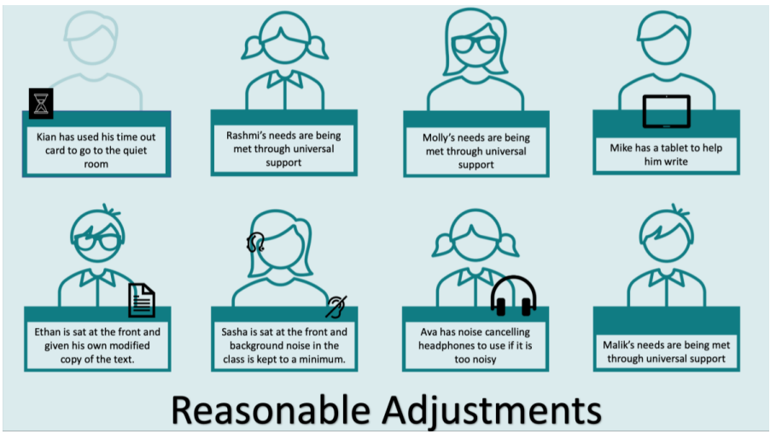
Universal Support – Inclusive Quality First Teaching
For most children, settings and schools are able to support their needs through adjustments made to the quality first teaching.

Slide 9
‘Good teaching for SEND is good teaching for all’
Whole school approaches
Zones of Regulation
Calm spaces
Movement / regulation breaks
Visual timetables and use of visual prompts
Use of manipulatives/practical resources

Slide 10
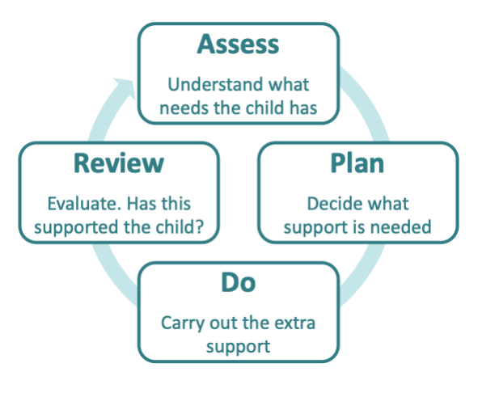
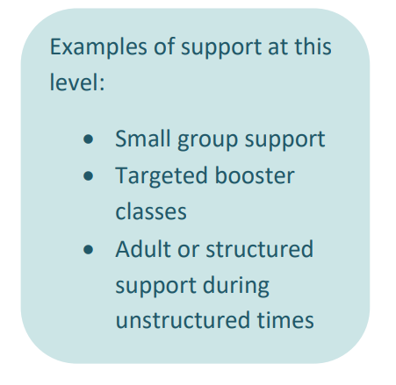
Targeted Support (zippy)
For some children, they might need a bit more support to meet their needs. If a child or young person has identified needs, settings and schools should go through a process called The Graduated Approach.
Parents will be informed of this support at parent’s evening.

Slide 11
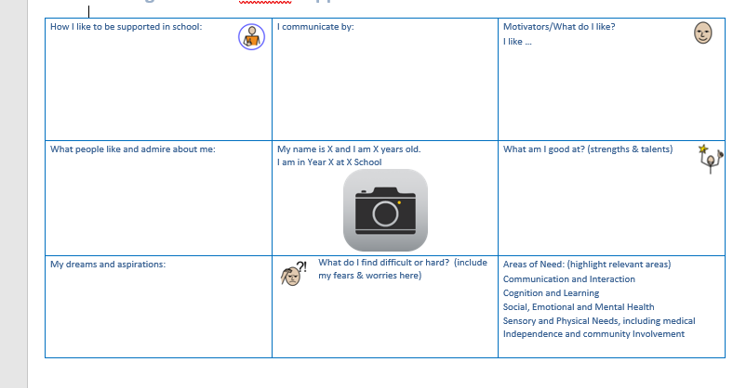
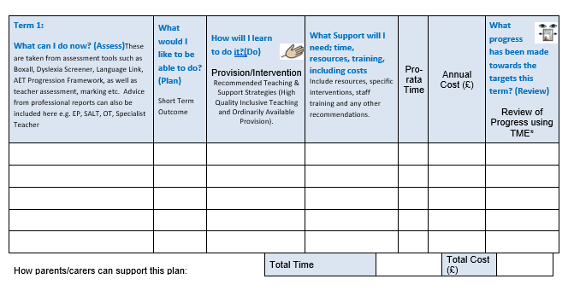
SEN Support
If a child has had a number of interventions and the impact of these have been assessed through the APDR cycle, it may be decided that further support and intervention is required. The school, parents and child will be involved in the creation of a SEN Support Plan. This gives a personalised account of the child's journey so far and the next steps in terms of their support and expected outcomes.
Also details interventions and tracks progress against outcomes

Slide 12
Communication and interaction
Visual prompts
Cognition and Learning
Phonics interventions
Specialist teacher
Social emotional and mental health
Social stories
Early Help
Sensory and/or physical
Visual timetable
OT
Processing time
Modelled language
Writing frames
Now/next board
Visual timetable
Nurture group
Social stories
SALT
Specialist teacher
CAMHS
Educational Psychologist
SALT
OT
Educational Psychologist
SALT
Movement breaks
Differentiation
Visual prompts
Visual timetable
Pe-teaching
Different ways to read/record
Chunked tasks
Nurture
Counselling/ play therapy
Zones of regulation
Play based activities
Responsibilities in class
Consistency
Choices
Structure of the day
Time out
Reward charts/ catch me cards/ reward time
Safe/ quiet place
Educational Psychologist
Pupil Referral Unit
OT
Visual cues
Seating plan
Enlarged resources
Specialist equipment
IHCP
OT
Individual work station
Flexible approach
Safe space
Paediatrician
School Nursing
SALT
Educational Psychologist
Physiotherapy Service
Portage
Language Link
Speech Link
Safe space
Movement breaks
Adjusted seating/ sensory objects
Maths interventions
Pre/post-teach
Times tables
Assistive technology
Adapted texts
Sensory circuits

Slide 13

What makes us special?
Relational approach – relationships built on mutual respect
Child-centred approach
Use of the Bubble
Use of the Outdoor Classroom
Trained ELSAs
Nurture Group
Wycombe Wanderers mentoring scheme
Trusted 5
Out of class SENDCO

Slide 14
Next steps
External Agencies:
OT advice/ webinars/ referral
SaLT advice/webinars/ referral
Physio
CAMHS
Early Years Advice
Specialist Teacher Service
PRU
SEND Advisor
Educational Psychologist
ELSA/ Nurture/ Active interventions/ mentoring

Slide 15
Further Support
Higher Needs Block Funding
Education and Health Care Plan
Assessment/ diagnosis not required – evidence of the support in school and the needs of the child

Slide 16
WHat to do if you have a concern
In the first instance, talk to the class teacher
SENDCo always available for advice and support – book through office or find me on playground
School website for FAQs
Bucks Local Offer – award-winning
SEND sessions at soft plays/ play areas/ swimming pools/cinemas
SENDIAS – advice and support

