Slide 1
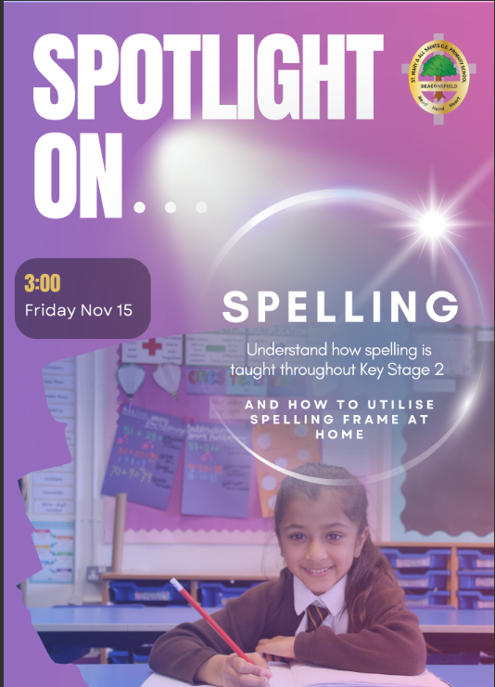
Can you work out the rule for using the -able and –ible suffix?
incredible
comfortable
predictable
edible
responsible
possible
enjoyable
readable
fixable
sensible
Notes:
Did anyone manage to work out the spelling rule and pattern? Come back to this in a min.

Slide 2


Slide 3
Outline our approach to teaching spelling
Understand the reasons for the adaptation to spellings
Clarify how spelling is set and assessed in Key Stage 2
Provide guidance for supporting at home
Answer any questions you may have
Notes:
Outline our approach to teaching spelling
Understand the reasons for the adaptation to spellings
Clarify how spelling is set and assessed in Key Stage 2
Provide guidance for supporting at home
Answer any questions you may have
Time for questioning at the end ,

Slide 4
How we teach spelling
Outline
Children introduced to their spellings in groups
Differentiated lists
Focus on patterns and rules
Notes:
Monday- chn set new spellings and introduced to these spellings. This is usually done just for 10-15 mins as part of their starter for English.
Can be in smaller groups as chn have differentiated lists.
Varies the number of spellings they have based on the rule – we want to be using words children understand and can use. E.g. sub prefix subversive - this is not relevant to a child
Patterns and Rules- Like some of you worked out on the first slide. Chn talked through the pattern or rule for their spelling list. E.g. using ck or k or when to use –able or –ble as a suffix. Obviously there are some exceptions to the rules and they are words that chn become more familiar with.

Slide 5
Can you work out the rule for using the –ck or –k rule?
Lock
Bleak
Sack
Bank
Black
Creek
Crick
Peek
Back
Cloak
Block
Seek
Chick
Shriek
Notes:
Another brain teaser… Can you work out the rule?
Short vowel sound you use –ck and longer vowel sound or a partner you can use just –k.
Show AI. This is for parents not the chn. If you are needing some support for yourself, use AI to help you with knowledge.

Slide 6

Understand
Consistent Progression
Interactive & Engaging
Supports Independent Learning
Instant Feedback
Notes:
Understand the reasons for the adaptation to spellings
We have been using online platform of spelling frame to allow chn to practise their spellings. This what spelling frame offers which is why we have used it.
Consistent Progression:
The program provides a structured, progressive approach, with words and activities that build on each other year by year.
Interactive & Engaging:
Spelling Frame offers interactive activities, games, and quizzes that make learning fun and allow for more active participation.
Supports Independent Learning:
Children can practice at their own pace, at school or at home, reinforcing what they’ve learned in class.
Instant Feedback:
The platform gives instant feedback, helping children learn from mistakes and track their own progress.

Slide 7

Understand
Better Alignment with Curriculum:
Aligns more closely with the National Curriculum
Learning words and rules suitable for their ability, or their year group expectations.
Personalised Learning:
Provides a more individualised approach
Allows teachers to tailor spelling lists to the needs of each child based on their progress.
Increased Engagement:
The interactive, game-based format helps maintain children’s interest
Motivates children to make spelling practice less of a chore.
Supports Home Learning:
Online platform makes it easier for children to practise spellings at home
Provides parents with clear, accessible tools to support their child.
Notes:
With every decision we make we always want to look at the ‘why’? If we can’t justify how something directly impacts pupils in a positive way, we won’t change.
Go through each point
Ensures the chn have a deeper understanding of spelling rules and patte. ns

Slide 8

Advantages of Spelling Frame
Understand
Reads word aloud – pronunciation
Puts it into the context – develops vocabulary
Gives the meaning – understanding
Track scores over time – progress
Earn points – engagement and motivation
Segments the word
Creates a ‘tricky word’ list
‘Printables’
Notes:
Printables are important as they have the word lists. Spelling Frame can be used creatively or adapted to suit the needs of your child. We are using it as a tool to help engage chn and see increase with spelling practise. We are aware that chn learn differently and you may not feel this is the best thing for your child.

Slide 9
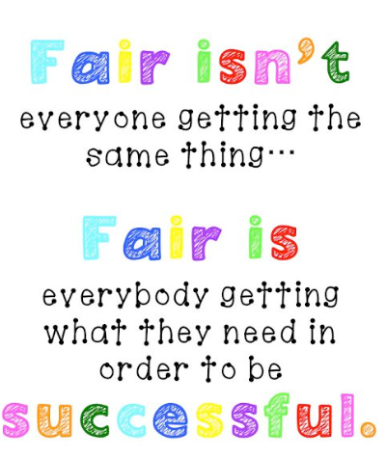
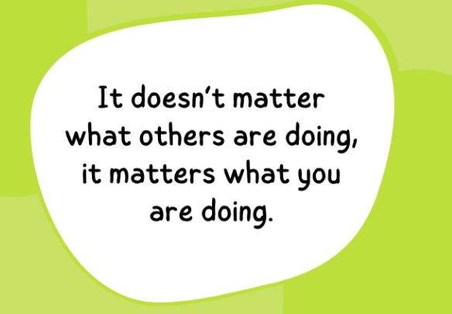
Assessment and Spelling Lists
Clarify
Assessment
Termly SPaG assessments
Ongoing assessment through writing
Based on children’s abilities not their age
Spellings are in line with the National Curriculum
Spelling Lists
Notes:
Clarify how spelling is set and assessed in Key Stage 2
Assessment – read and then say this will the ensure that children are getting adapted spelling lists suitable for them if they have a weaker area with their spelling.
If a child has been identified as having a specific weakness with spelling in general, or a certain spelling rule, spellings can be adapted. If there is no additional need identified chn will be given spellings for their year group in line with NC.
Can easily be moved onto different spellings if children make accelerated progress and can be given an adapted set from ARE if needs be – we must remember that we worry about ourselves and not what others are doing.

Slide 10
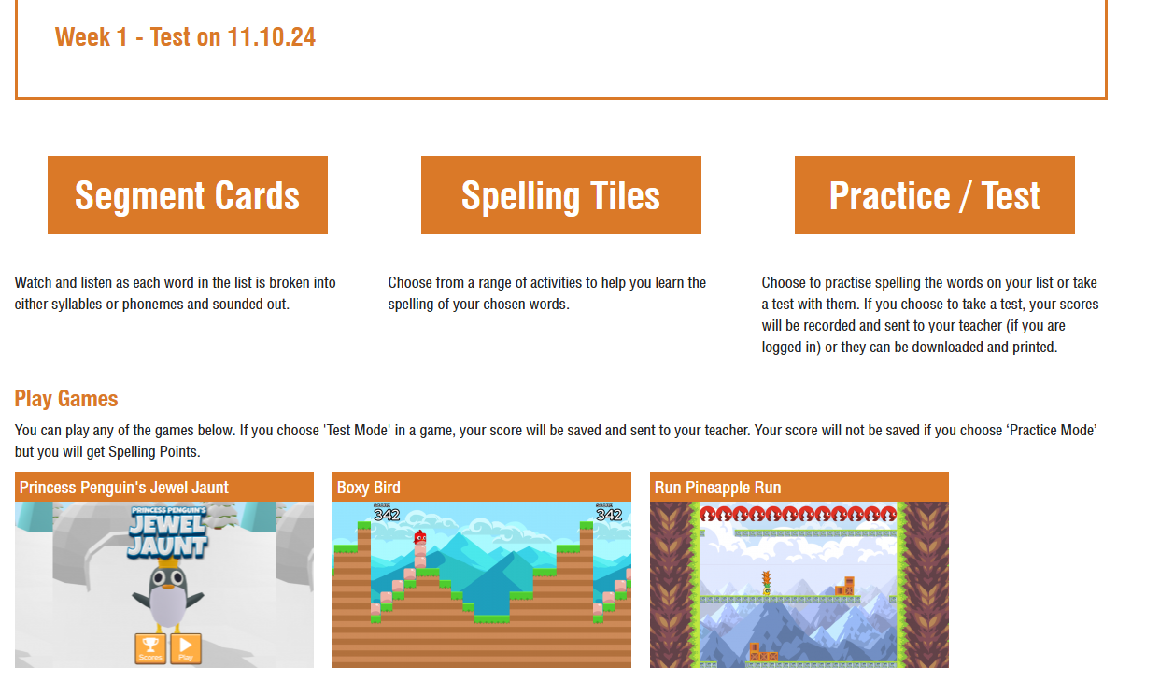
Recommendation for practise
Provide
1
2
4
Segment- introduces in context
Spelling Tiles- deeper understanding
Games- engage and motivate children
Practice - practise in the testing style
3
Notes:
Provide guidance for supporting at home
Recommendations for spelling frame practise-
Will give you a demo of this in a minute.
Segment- introduces the spellings and give the words in context. It segments into the different sounds.
Spelling Tiles- helps chn to learn the spellings and have a deeper understanding
Games- engage and motivate and practise
Practise- practise the spellings in test style.
Do not test at home.

Slide 11
How to use and the features available…
Spelling Frame Tutorial
Provide
Notes:
Segment
Spelling tiles
Practice games
Practice test
Printables
Dashboard
View results
Tricky words- view current words and add to
Printables are important to have access to. Aware that parents are wanting to limit screen time. Obviously we are on board with this but screen time becomes an issue if it is not being used to stimulate our brains positively.
If an issue to print at home, speak to the class teacher.

Slide 12

Additional ways to support..
Provide
Printing lists
Use spellings to practise handwriting
Encourage regular practise
Use positive language to encourage your child to actively engage with their spellings
Challenge
Use in a sentence
Explain the spelling rule or pattern to a family member
Create a game e.g. wordsearch, boggle
Write the word in different forms e.g. past tense, plural, adverb
Notes:
Go through the ways to support
Challenge- if you think that spellings are not challenging enough, here are some other ways at home that you can challenge.

Slide 13

Any questions?
Answer

Slide 14
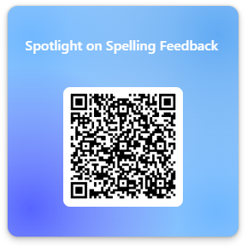
Feedback
Please fill in the feedback form so that we can make improvements for next time!

