Slide 1
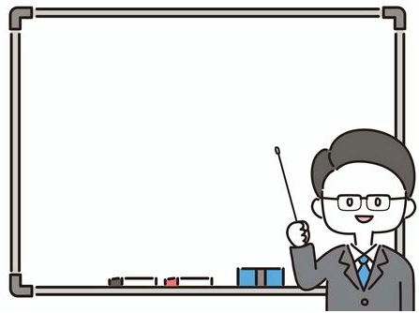

St Mary and All Saints Church of England Primary School
Meet the Teacher
Reception
Miss Moss & Mrs Henton
Date

Slide 2
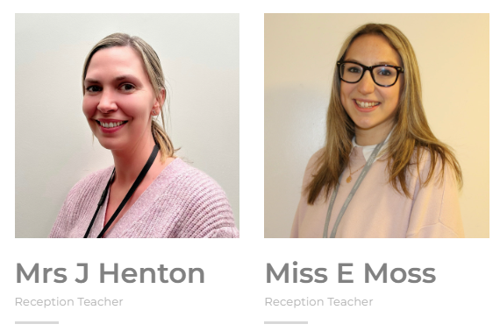
Who’s Who

Slide 3
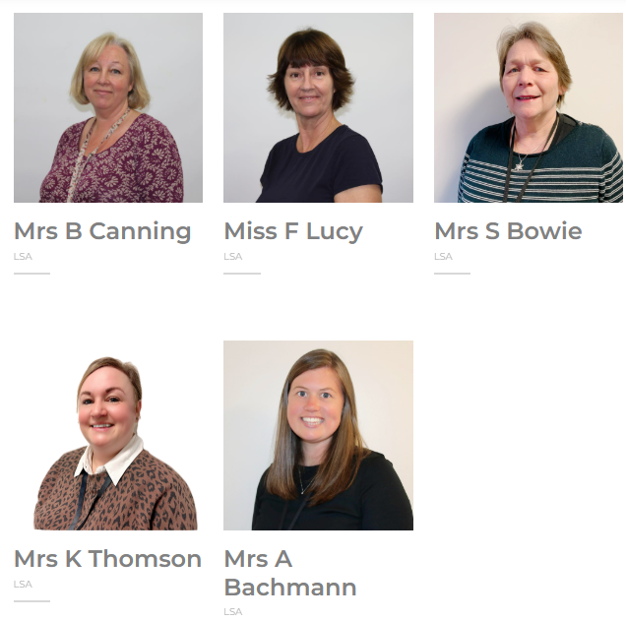
Who’s Who

Slide 4
St Mary and All Saints Church of England Primary School
The School Day
8.45am: Soft start
8.55 – 9.10: Morning jobs & registration
9.10 – 9.30 – Phonics
9.30 -10.30 – Continuous Provision (Literacy or Maths Task – T led)
10.30am-10.45: Snack & Milk
10.45 – 11.00 – Class input (Literacy/Maths)
11.00-11.45 - Continuous Provision (Literacy or Maths Task – T led
12.00pm: Lunchtime
1:00pm – 1:10pm Registration & Calm time
1:10pm-1:30pm Carpet input
1:30-3:00 – Continuous Provision
3.00pm: Tidy up and story time
3:25pm: Home time
Pick up arrangements in writing, including Curl around arrangements.
Notes:
Remember to tell parents what could be discussed on the playground.

Slide 5

Our Curriculum
Notes:
Be given a sheet with what is covered in each topic.

Slide 6
Trips/’wow’ experiences
Autumn Term: Dentist, Diwali, Hot Chocolate, Christmas Play, Autumn walk
Spring Term: Chinese new year, Spring walk,
Summer Term: Summer walk, School trip – Black Park.
More exciting experiences TBC!!
Notes:
If you don’t have these finalised, only share what you know will happen!
Following childrens interests.

Slide 7
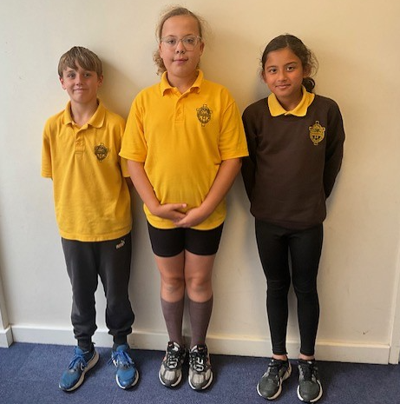
PE
PE day = Thursday
Taught by: Miss Moss/Mr Allison
PE Kit – yellow shirt, black shorts, black joggers or leggings, jumper, plimsolls and trainers
Tracksuit bottoms in winter

Slide 8
Home Learning
  Set on Seesaw
  Log in codes will be sent home
  Learning buffet will start in Spring term
  Reading – every day (Shared picture book to start with)
  Phonics books once assessed.

Slide 9

Recording reading- KS1
Twice weekly book change
Monday and Thursday
Parents record in reading diary
Notes:
Explain how you would like these to be used by pupils and parents and the purpose of them for the children. You may wish to screen grab an example.

Slide 10
Equipment
We always need tissues!!!
Spare clothes/underwear in bags please!!!
Any spare underwear that could be donated would also be amazing.

Slide 11
Behaviour/Reward Systems
House points- whole school
Shine Scale – Positive reward system
Star in the jar – class work together to get a reward.
Positive reinforcement
Reflection time – an opportunity to reflect on
behaviour and discuss strategies moving forwards.
Notes:
Reflection -

Slide 12
How we inform you of the progress your child is making
Parents Evening Consultations (Autumn & Spring)
Conversation with class teacher at appropriate times
Book Look sessions
Annual Report (Summer Term)

Slide 13
How we communicate with parents
Class letters at the start of each term
Head’s Highlights
Open evening/Parents’ evenings
Book look
Parent Mail
Open door policy
Seesaw (Homework only)
Appointments with teachers via office

Slide 14
Home-School Agreement
Our home-school agreement is a statement explaining:
The school’s aims and values;
The school’s responsibilities towards its pupils who are of compulsory school age;
The responsibility of each pupil’s parents; and ▪ what the school expects of its pupils
Please read and sign with your child. Then return to class teacher.

Slide 15
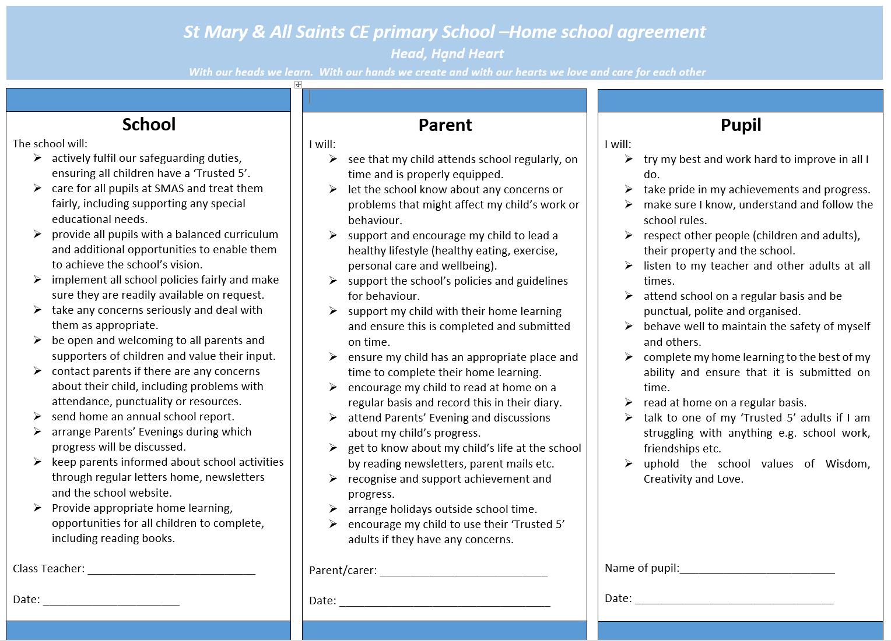

Slide 16

Trusted 5

Slide 17
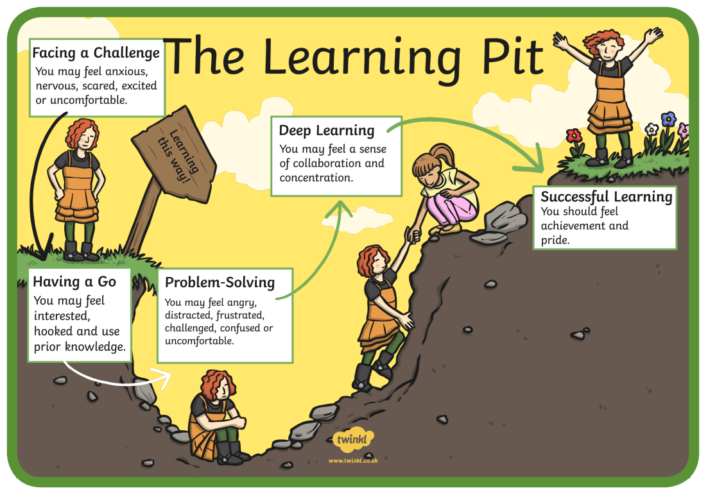
The Language of Learning

Slide 18
Any Questions?

